Slide 1
ARS Compliance Portal Training Session Compliance Oversight Plan Feedback Process & Tools
Levon Yon
Manager, External Compliance Monitoring - ARS
Cameron Chung
Senior Compliance Specialist (O&P)
Jane Mahilom
Compliance Monitoring Analyst
Shuchismita (Shuchi) Singh
Senior Business Analyst

Slide 2



Purpose & Agenda
Purpose
To explain the Compliance Oversight Plan (COP) distribution and feedback process
Agenda
Background and update regarding the Alberta Risk-Based Compliance Monitoring Program (ARCMP) and COPs
Flowchart of COP sharing and feedback process
Distribution and Interaction Mechanism (AESO Portal)
Communication channel
Market Participant side of the process
System notification from AESO to MP
Providing feedback on the COP to the AESO
AESO uploading final COP to MP registration
Useful Links
Demo
Questions & Answers
Public

Slide 3

The Plan
At the end of this tutorial, you will be able to:
Receive the latest update regarding the ARS Enhancement project.
Explain on a high level, what are the ARCMP and the COP.
Explain specifically “How” the Draft COP will be distributed to your company.
Know the “What” and “How” to provide feedback on your COP and the options available to your organization.
Know “Where” your organization’s COP is located once it is finalized.

Slide 4
ARS Enhancement, ARCMP and COP Update
Levon Yon
Manager, External Compliance Monitoring - ARS

Slide 5
Alberta Risk Based Compliance Monitoring Program (ARCMP)
ARCMP in effect on June 1, 2024
Replaces Compliance Monitoring Program by end of 2024
Focuses oversight on areas that pose the highest reliability and security risks to the Interconnected Electric System (IES)
Reduces administrative burden for Market Participants (MP) and AESO, enhances effectiveness and efficiency
Improves oversight monitoring tools and ensures oversight is commensurate with the level of risk posed by each MP
Better aligns oversight practices with other jurisdictions
Public

Slide 6
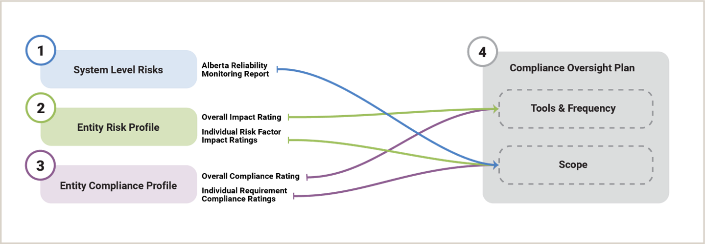
ARCMP Processes
Public

Slide 7
Compliance Oversight Plan (COP)
PDF document contains:
System Level Risks and related requirements that AESO monitors
Entity Risk Profile
Alberta Risk Factors criteria, risk rating, and explanation
Overall risk profile – High, Medium, Low
Entity Compliance Profile
Demonstrated Exceptional Performance Determination - top 25% of MPs in each risk profile category with fewest audit identified suspected contraventions during two most recent
Compliance Oversight Strategy
List of ARS requirements AESO will monitor, and associated monitoring tools and frequency potentials based on risk profile and compliance history
Public

Slide 8
Next Steps
August
September to October
Q4
- Deliver refined ARS
monitoring processes to
ensure roll-out is successful
- Provide entities with COP schedule
- Prioritize for first year of monitoring activities
- Send first monitoring notifications, begin monitoring
- Distribute COPs for entity review and feedback
- Feedback required for entity risk profile only
- Provide entities final COPs that include corrections/feedback
Public

Slide 9
COP Distribution & Feedback Process
Shuchismita (Shuchi) Singh
Senior Business Analyst

Slide 10
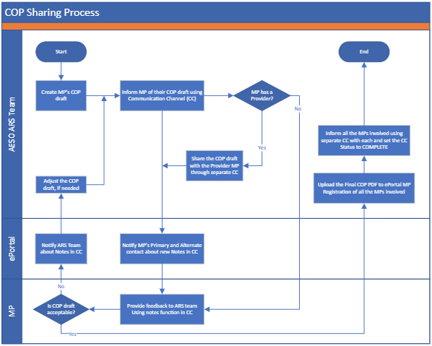
COP Distribution and Feedback Process
Public

Slide 11
The Tool and What Will Happen
Cameron Chung
Senior Compliance Specialist (O&P)

Slide 12
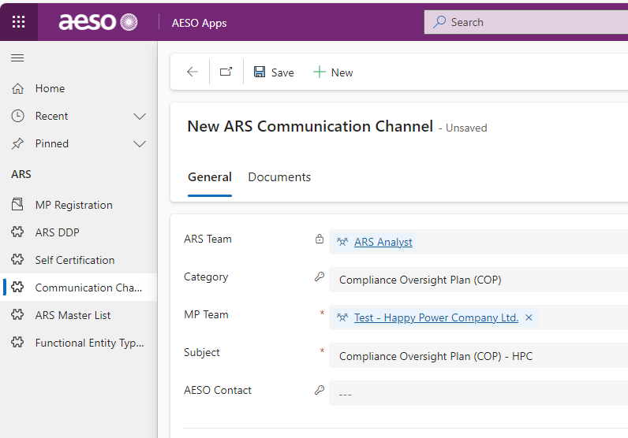
Communication Channel
Important Takeaway
Your organization’s draft COP will be distributed using the AESO Portal’s Communication Channel.
Log into the AESO Portal.
Communication Channel can be accessed on the left column under “ARS”
ALL communication and feedback MUST be conducted using Portal Communication Channel.
Documentation and retention purposes
Streamlining feedback and response
Public

Slide 13
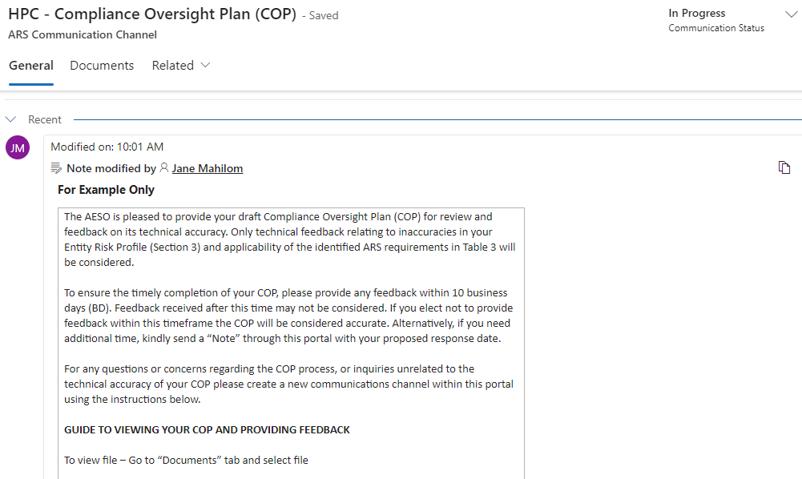
Communication Channel – Initial Note
Example Text Only
(Specific Language to be finalized.)
Important Takeaway
“Only technical feedback relating to inaccuracies in your Entity Risk Profile (Section 3) and applicability of the identified ARS requirements in Table 3 will be considered.” – Have impact to the finalization of your COP.
Public

Slide 14
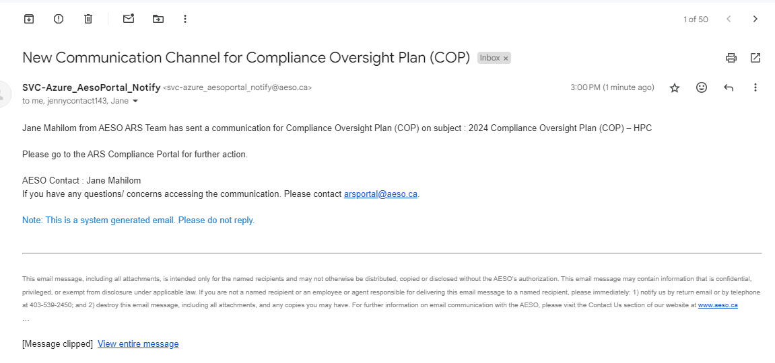
System Notifications to MP Contacts
Important Takeaway
System Generated Notification Email
Primary and Secondary Contact
Do not reply to this email.
Public

Slide 15
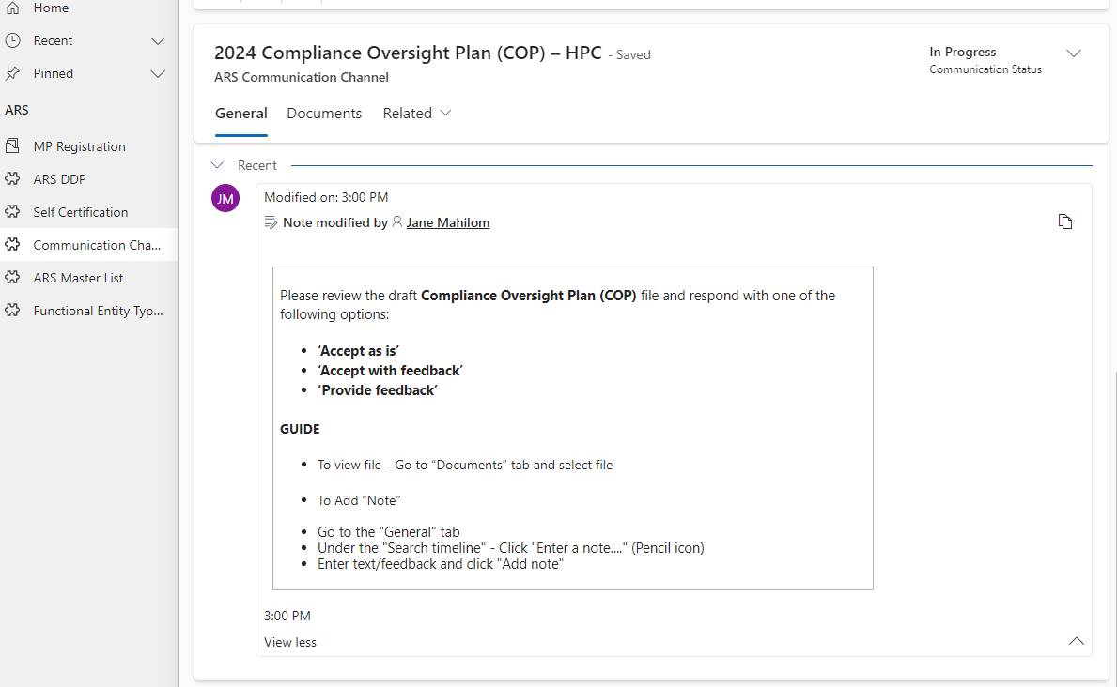
Communication Channel View - MP
Example Text Only
(Specific Language to be finalized.)
Public

Slide 16
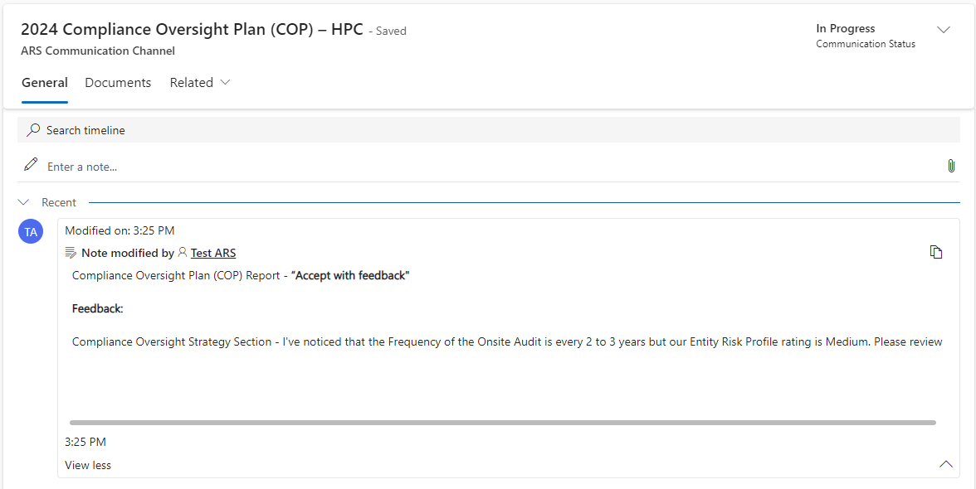
MP Channel View – Initial Response
Public

Slide 17
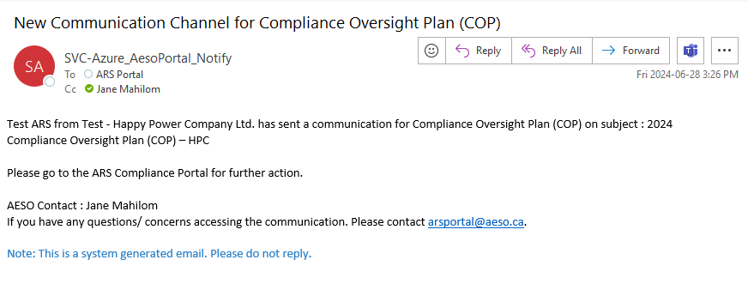
System Notification to AESO
Public

Slide 18
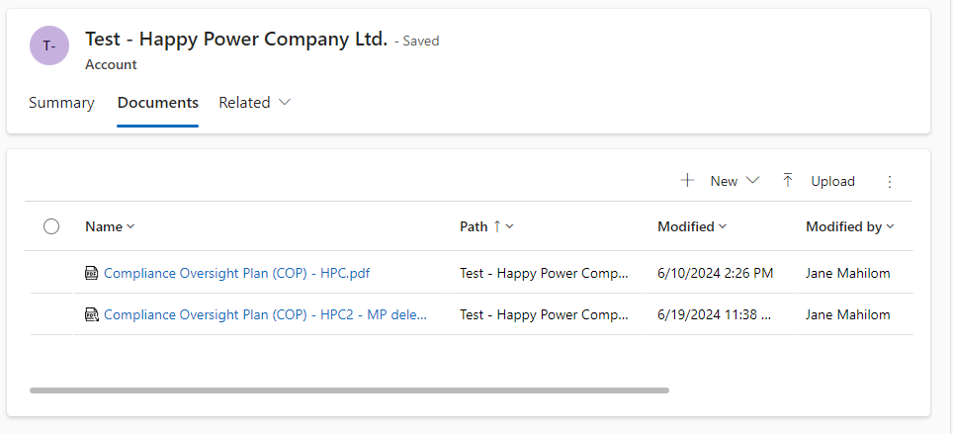
MP Registration – COP Report
Public

Slide 19



Useful Links
ARS Compliance Portal Guide (Will be updated shortly)
Alberta Risk-Based Compliance Monitoring Program (ARCMP)
Alberta Reliability Risk Priorities Report
Alberta Entity Risk Factors Criteria
Public

Slide 20
Questions before the Demo?

Slide 21
Absolutely Amazing and Spectacular Demo
Jane Mahilom
Compliance Monitoring Analyst

Slide 22

Contact the AESO
Twitter: @theAESO
Email:
info@aeso.ca
rscompliance@aeso.ca
arsportal@aeso.ca (Best location)
Website: www.aeso.ca
Subscribe to our stakeholder newsletter
Public

Slide 23
Questions and Feedbacks

